Slide 1
APS Material Scanning
Alex Nishio

Slide 2
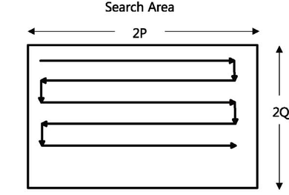
Overview
Overall goal is to replicate x-ray ptychography or diffraction microscopy
Scan tiny organisms in μm size using x-ray beam light in nm size
Search area is similar to the left diagram

Slide 3

Overview
Given 1640 different images similar to the left image
Goal is to locate the exact position of the white dots and create a small patch on it
Exact coordinates will be patched on other 1639 images
Lining patches together supposedly can show different materials?
Check next slide for example
Disclaimer: seems a little bit more complicated than this but did not get to research far enough

Slide 4
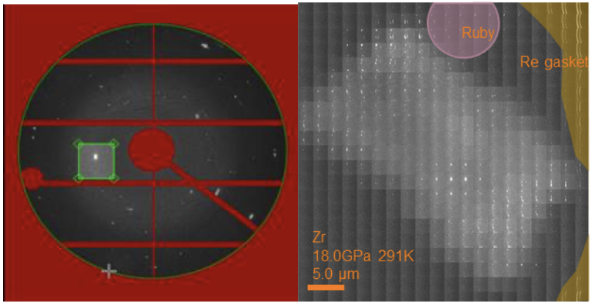
Visualization of Patching Result (Example from Dioptas Software)
Patching from 1 image
Patching from 1640 images

Slide 5
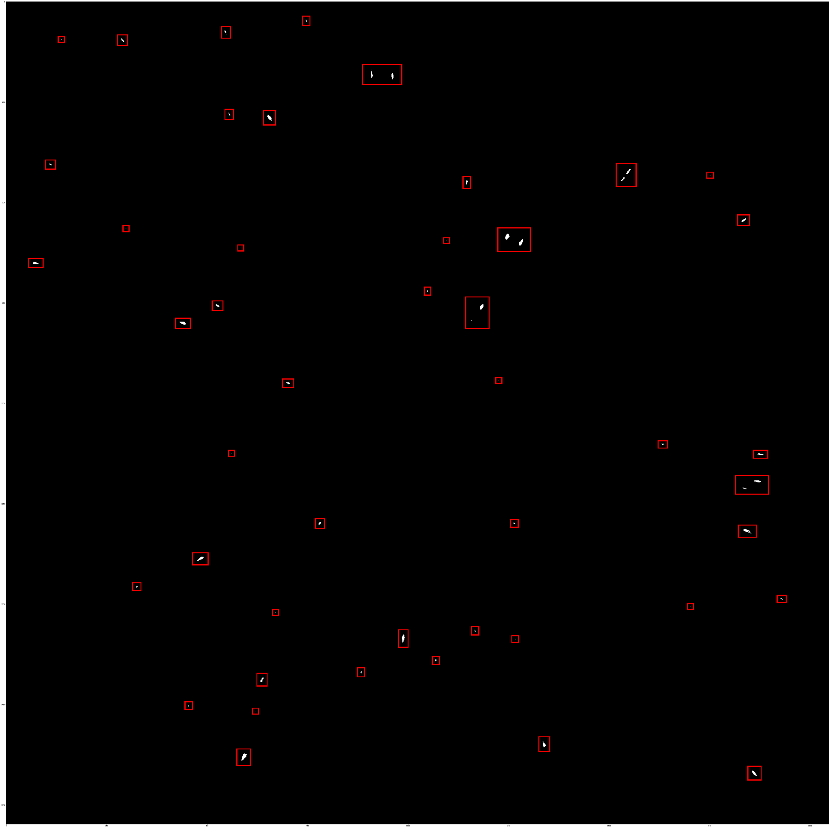
Results
Original
Output
Quick proof displaying the patching worked using open-cv

Slide 6
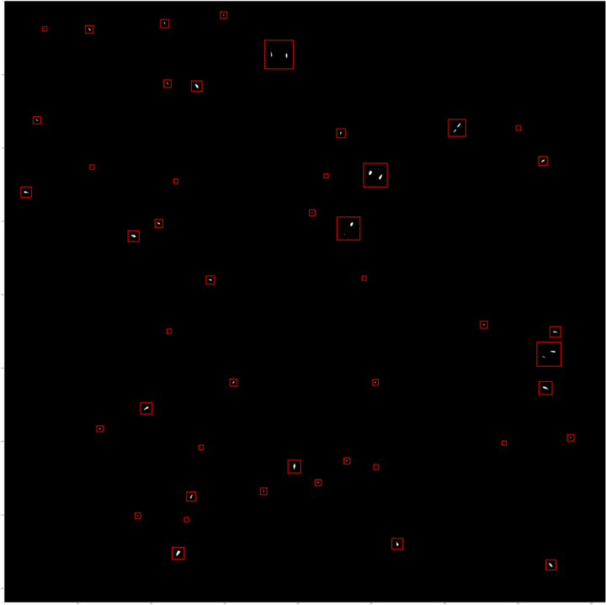
Quick update changing the rectangular patches to square patches

Slide 7
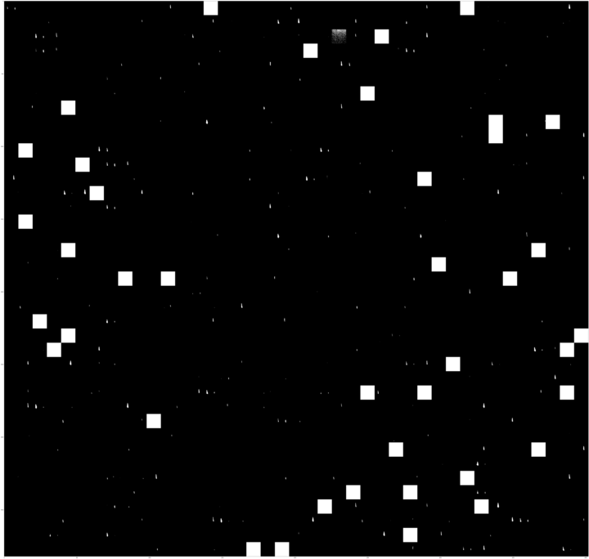
Example of one of the patches created (failure)
Ultimately could not extract any meaningful data from this patched image when using methods above
White squares seems to be a cv2 rendering issue
Should try to render rgb values past 255
Potential solutions:
Replace white squares with fully black squares
Use rasterio instead of open-cv

Slide 8
Overall Outlook
Project is difficult to proceed without any background knowledge on x-ray diffraction microscopy
Ideas for improving the project:
Consulting an expert on
how to use diffraction microscopy softwares (Dioptas)
how the patching process works
how minerals and atoms are specifically identified from performing such steps

Slide 9
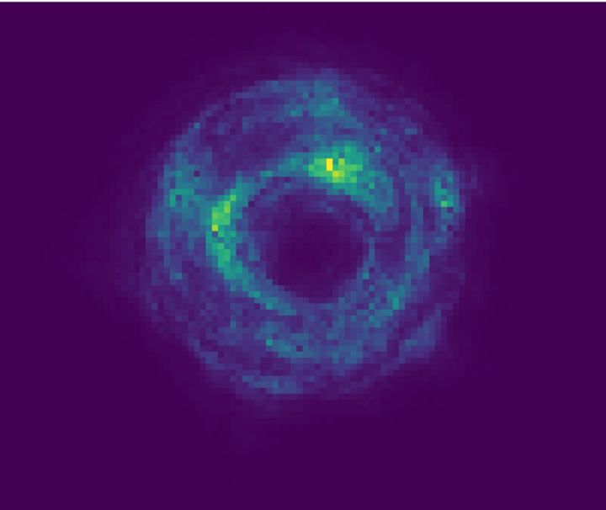
Additional Resources
Example patch in Argonne’s solution
Potentially the same methodology as this project
Argonne’s X-ray microscope
Argonne’s article
https://www.anl.gov/article/scientists-pioneer-new-xray-microscopy-method-for-data-analysis-on-the-fly
Research paper
https://www.nature.com/articles/s41467-023-41496-z
Numpy array with 121 scans with 943 patches each
https://zenodo.org/records/8121606
Official GitHub page
https://github.com/vbanakha/edgePtychoNN

Slide 10
Overall Future Goals
Successfully patch from 1640 images
Once enough patches are made, find some correlations and train a ML model
Classification
Segmentation
LM based captioning
Regression

